Slide 1
MAJOR PROJECT
HOSTEL MANAGEMENT SYSTEM
Guided by:
Dr. Barnana Baruah
Associate Professor
Department of IT,CSE
Sayanka Sikhar Barman (ET18BTHCS001)
Rohit Kumar Singh (ET18BTHCS009)
Mushtaq Mohd Rejowan (ET18BTHCS035)
Arpita Gogoi (ET18BTHCS046)
Udit Kashyap Barman (ET18BTHCS047)

Slide 2
OBJECTIVE
System for management registration in a hostel
To make the process smooth and easy
Reduce time by dropping traditional paperwork system
Ensure safety during emergency situations
To make the process online

Slide 3
INTRODUCTION
Hostel management system is the system that manages the student data which can be stored and retrieved easily.
This system is designed in favour of the students and administration by helping them to save or retrieve the records of the students such as phone no, email id etc. It is a method that is superior to the traditional paper records system.

Slide 4
TOOLS & TECHNOLOGIES
HTML/CSS - To structure the webpage.
JavaScript - To make the content dynamic and creative.
Bootstrap 5 - Website designing.
PHP - General purpose scripting language.
MySQL - To interact with the database.
Sublime text/Brackets - Source code editor.
XAMPP- Cross platform web server.

Slide 5
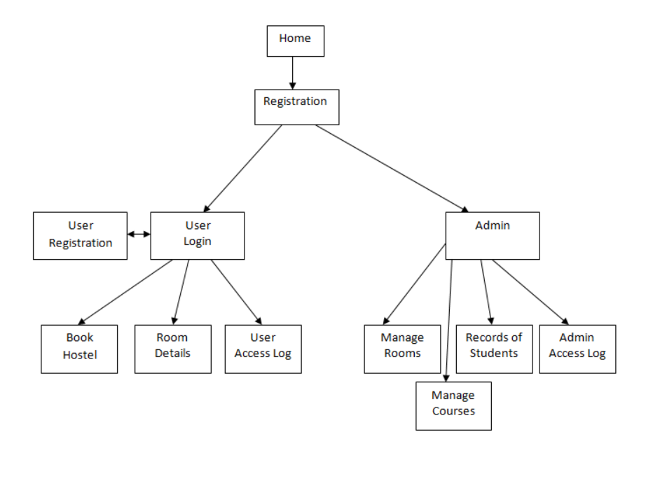
ARCHITECTURE OF THE SITE

Slide 6
DEMONSTRATION
Local Server Link:
localhost/hostel/home/index.php

Slide 7
BENEFITS
User friendly
Flexible
Saves time
Centralized database
Secure user information

Slide 8
FUTURE PROSPECTS
To add chat feature to the site.
To add more users related to the operation of a hostel

Slide 9
CONCLUSION
This project offers user to complete the process in a simple and interactive manner. The data storage and retrieval process becomes faster and easier for the students and admins. The user is mainly more concerned about the validity of the data that they enter. There are checks on every stage of any new creation, data entry or updation so that the integrity of the data is maintained.

Slide 10


